Slide 1


SEMESTER -05
ENGINEERING CLINICS
PROJECT FALLSEM 2022-23

Slide 2
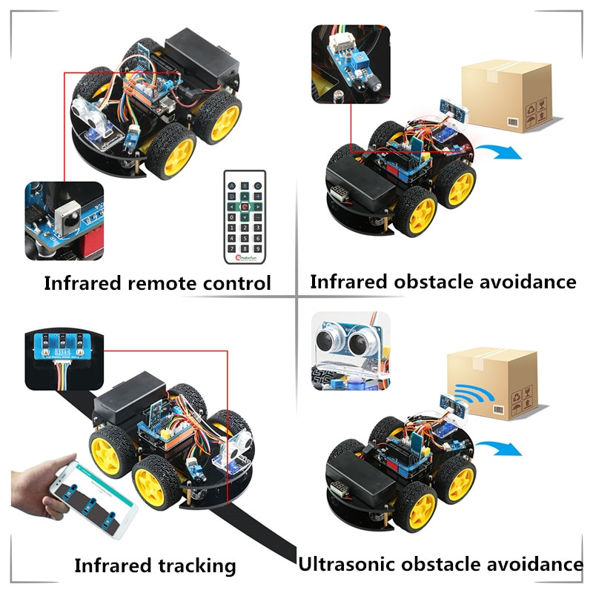

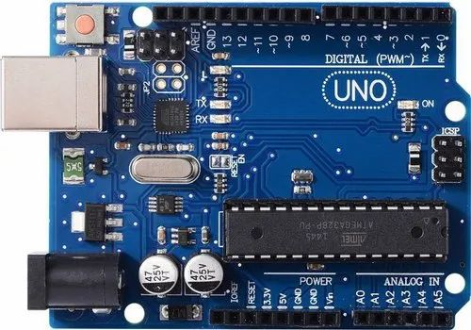
SMART ROBOT CAR USING ARDUINO
Android based smart robot control car

Slide 3
Agenda
Overall Flow Diagram
Bluetooth car flowchart module
Infrared obstacle avoidance flowchart module
Line tracking car flowchart module
Finder function software design flow chart

Slide 4
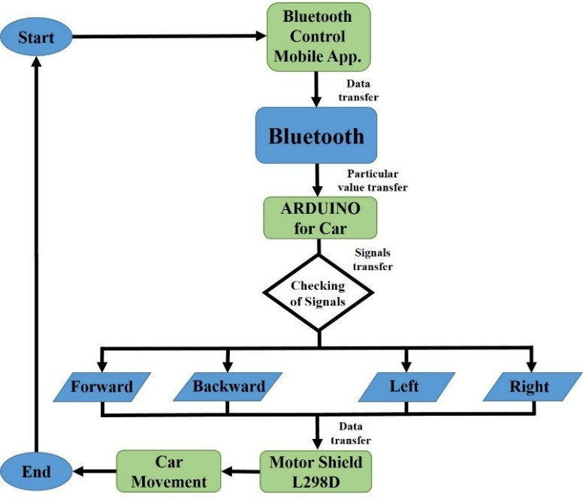
Overall Flow Diagram
Bluetooth car flowchart module

Slide 5
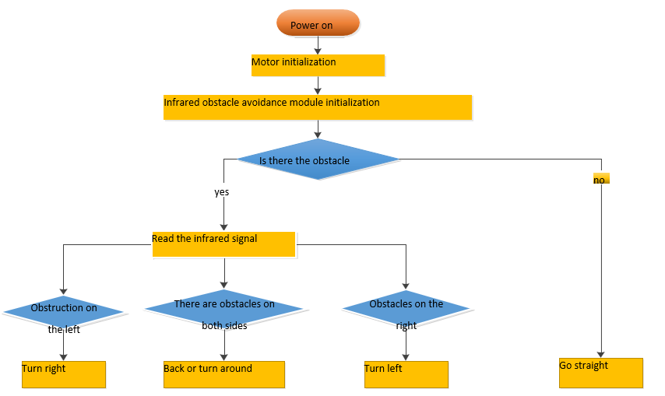
Overall Flow Diagram
Infrared obstacle avoidance flowchart module

Slide 6
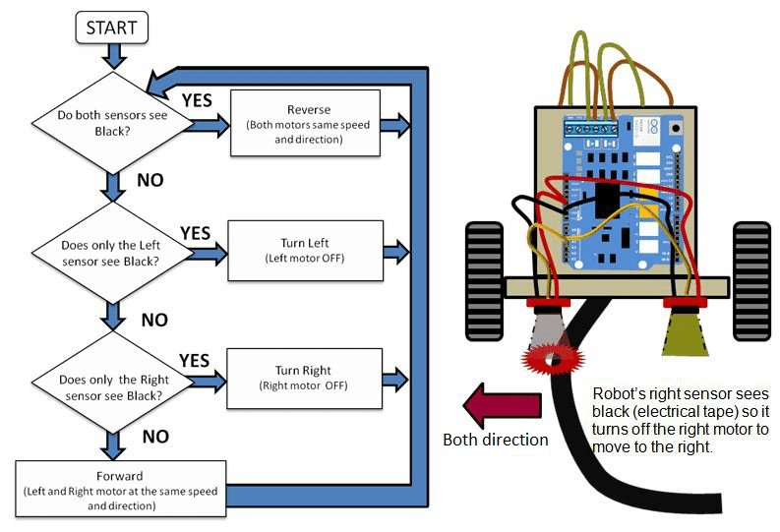
Overall Flow Diagram
Line tracking car flowchart module

Slide 7
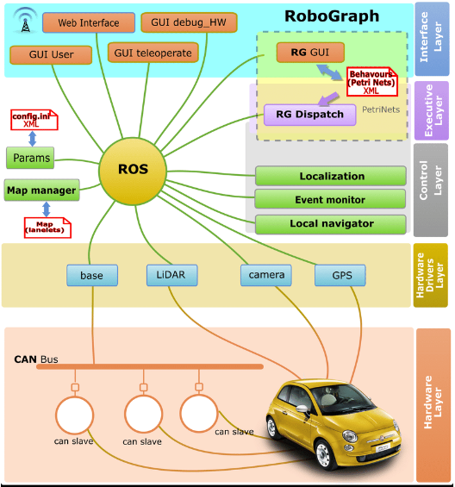
Overall Flow Diagram
Finder function software design flow chart

